Slide 1


Build a Personalized Online Course Recommender System with Machine Learning
Dianne Liu
April-03, 2023

Slide 2

Outline
Introduction and Background
Exploratory Data Analysis
Content-based Recommender System using Unsupervised Learning
Collaborative-filtering based Recommender System using Supervised learning
Conclusions
Appendix

Slide 3




Introduction and Background
Improve learners' learning experience via helping them quickly find new interested courses and better paving their learning paths.
With more learners interacting with more courses via your recommender systems, your company's revenue may also be increased.
Mainly focus to explore and compare various machine learning models and find one with the best performance in off-line evaluations.

Slide 4

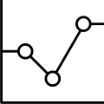

Exploratory Data Analysis

Slide 5
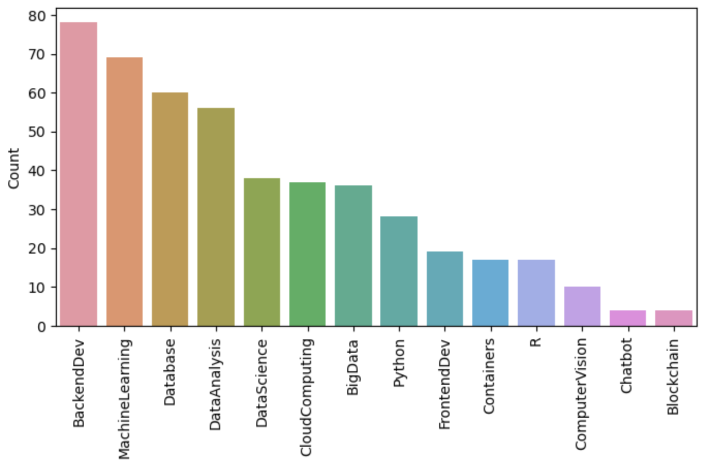
Course counts per genre
This chart shows all courses genre and the course count of each genre.
It is sorted by course count so that audience can easily find the most popular course genre
Notes:
Given all the course genres, now let's calculate the course count for each genre. e.g., there are 69 courses that belong to the MachineLearning genre and 23 courses that belong to the Python genre. We also want to sort the genre count list to find the most popular course genres.
Database 60
Python 28
CloudComputing 37
DataAnalysis 56
Containers 17
MachineLearning 69
ComputerVision 10
DataScience 38
BigData 36
Chatbot 4
R 17
BackendDev 78
FrontendDev 19
Blockchain 4

Slide 6
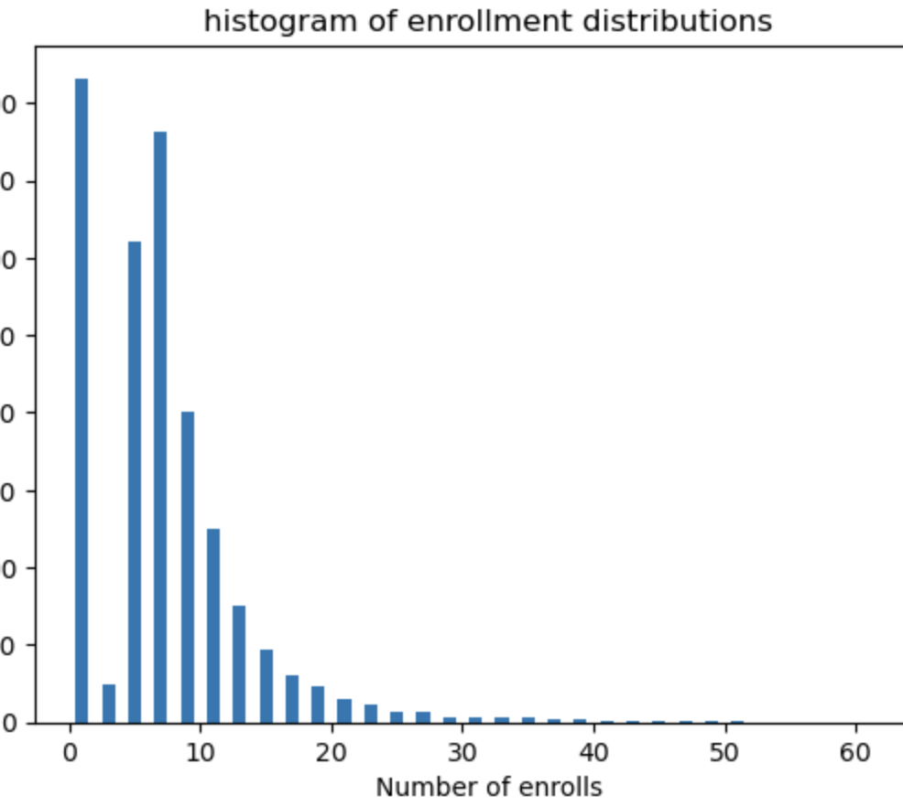
Course enrollment distribution
This histogram chart shows the enrollment distributions, e.g., how many users rated just 1 item or how many rated 10 items, etc.

Slide 7
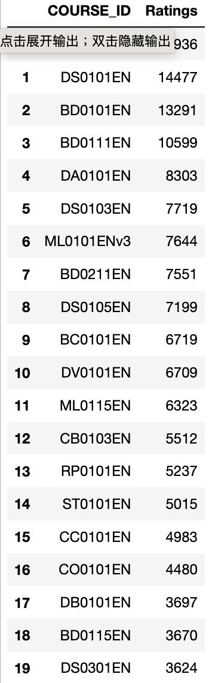
20 most popular courses
The list shows most popular 20 courses, i.e., items with the most rating counts.

Slide 8
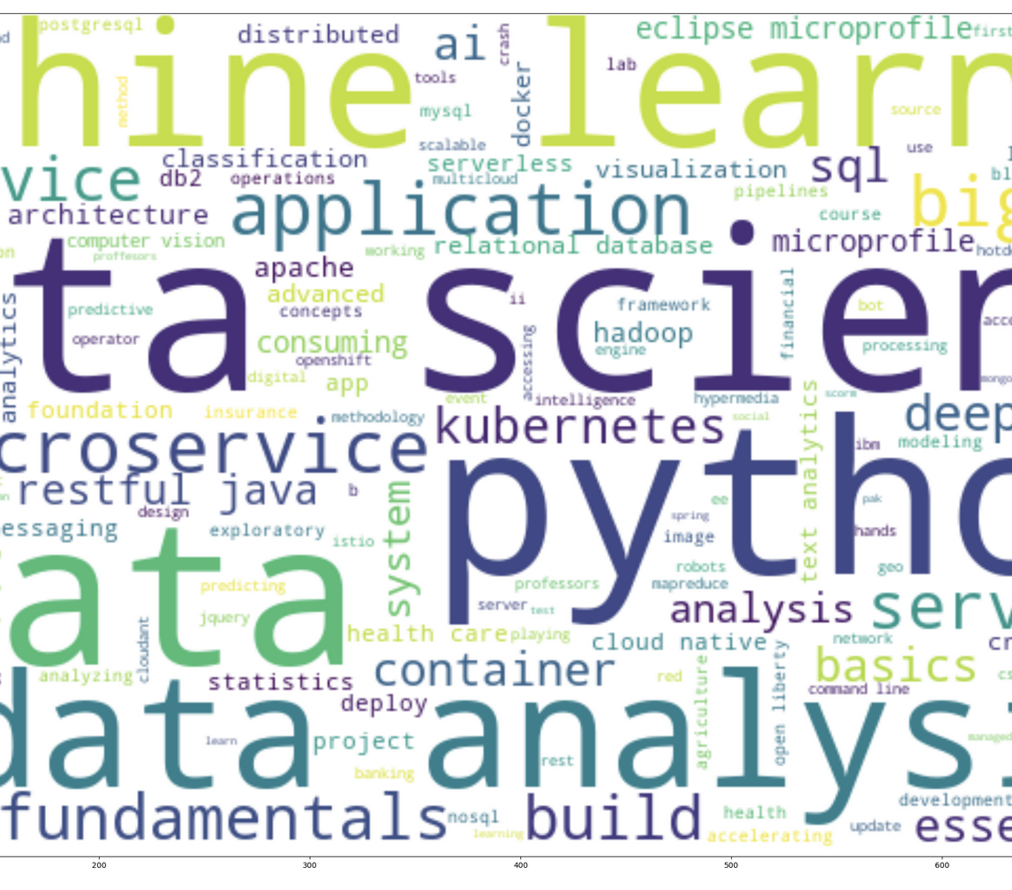
Word cloud of course titles
The word count are generated from the course titles
From the wordcloud, we can see many popular IT related keywords such as python, data science, machine learning, big data, ai, tensorflow, container, cloud, etc.
By looking at these keywords, we should have a general understanding that the courses in the dataset are focused on demanding IT skills.

Slide 9
Content-based Recommender System using Unsupervised Learning
Cluster2
Cluster1

Slide 10
Overview for Content-based Recommender System
The content-based recommender system is highly based on the similarity calculation among items. The similarity or closeness of items is measured based on the similarity in the content or features of those items.
Next we are going to introduce using the unsupervised machine learning method to build a content-based course recommender system. The features we will use to compute the similarity will be:
Course genres
User interest
BoW value (numeric feature vector transformed from course textual content)

Slide 11

Content-based recommender system - using user profile and course genres
The most common type of content-based recommendation system is to recommend items to users based on their profiles.
The user's profile revolves around that user's preferences and tastes. It is shaped based on user ratings, including the number of times a user has clicked on different items or liked those items.
The recommendation process is based on the similarity between those items. The similarity or closeness of items is measured based on the similarity in the content of those items. When we say content, we're talking about things like the item's category, tag, genre, and so on. Essentially the features about an item.
Next we are going to:
Generate user profile based on course genre and rating.
Transform the user profile to be numeric feature vector
Compute the interest score that also represents the recommendation score by computing dot product between a specific course matrix and a single user’s user profile vector
Recommend the new courses with high recommendation score to a user

Slide 12





Flowchart of content-based recommender system using user profile and course genres
Calculate a recommendation score for each unenrolled course with respect to each user
Recommend courses
User profile vector
Course genres vector for unenrolled courses
Select unenrolled courses with score > threshold (10)
Dot product
Process features
Final course recommendation
Check if count of recommended courses >20
ＮＯ
Load dataframe
ＹＥＳ
Remove courses NOT on top-20 high enrollments
User profile dataframe
Course genre and rating dataframe

Slide 13
Pipeline of content-based recommender system using user profile and course genres
Load
Load Dataframe
Load course genre dataframe: contains course id, course title, course attributes
Load user profile dataframe: contains course interest for each user
Load test dataframe: contains users to whom we want to make recommendation
Process
Process features
Create user profile vector based on course genre and rating
Create list of unenrolled courses for each user
With respective of each user, create course genre vector for each unenrolled course
Compute recommendation score
Calculate recommendation score by using dot product between user profile vector for a single user and the course genre vector for a specific enrolled course
Recommend
Recommend courses
Find the course with recommendation score greater than threshold (10) and add the course to the recommendation
Count recommended courses for each user. If the count is greater than 20, remove those courses with low count of enrollments, i.e. the enrollment count is NOT on top-20.
Compute

Slide 14
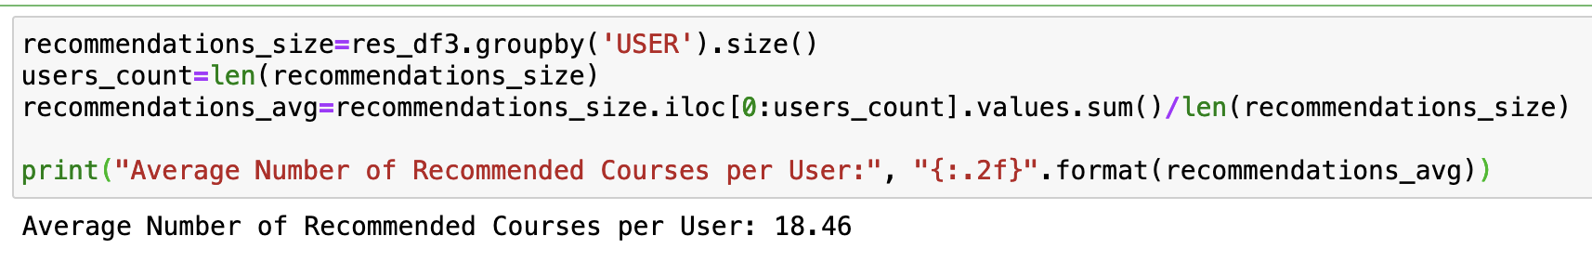
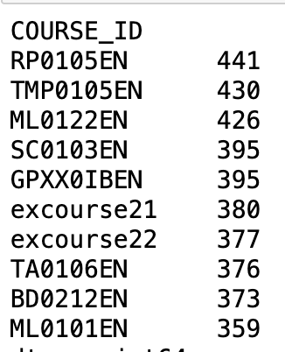
Evaluation results of user profile-based recommender system
Threshold for recommendation score = 10
Maxima count of recommended courses per user = 20
Question: On average, how many new/unseen courses have been recommended per user (in the test user dataset)?
Answer: 18.46
Question: What are the most frequently recommended courses?
Return the top-10 commonly recommended courses across all users

Slide 15


Content-based recommender system - using course similarity
The content-based recommender system is highly based on the similarity calculation among items. The similarity or closeness of items is measured based on the similarity in the content or features of those items. The course genres and users’ profile are important features.
In addition to course genre and users’ profile, BoW value is another important type of feature in numeric form to represent course textual content.
Next, we are going to apply the course similarities metric to:
Obtain the similarity between courses from a course similarity matrix
Use the course similarity matrix to find and recommend new courses which are similar to enrolled courses

Slide 16


Flowchart of content-based recommender system using course similarity
Calculate similarity for each unenrolled course with respect to each user
Recommend courses
Unenrolled courses
– similarity matrix
Enrolled courses
- similarity matrix
Select unenrolled courses with similarity score > threshold (0.6)
Calculate similarity
Process features
Final course recommendation
Check if count of recommended courses >20
ＮＯ
Load dataframe
Visualize similarity among courses
ＹＥＳ
Remove courses NOT on top-20 high similarity
Similarity matrix dataframe
Course content dataframe
BoW dataframe
Test user dataframe
Heatmap

Slide 17
Pipeline of content-based recommender system using course similarity
Load
Load Dataframe
Load the dataframe of pre-made course similarity matrix
Process
Process features
Compute similarity score
For each enrolled and unenrolled course, find its 2 indices (row and column) based on course id and then based on its indices to query its similarity matrix
Recommend
Recommend courses
Find the course with similarity score greater than threshold (0.6) and add the course to the recommendation
Count recommended courses for each user. If the count is greater than 20, remove courses with low similarity score, i.e. the similarity score is NOT on top-20.
Compute
Load the dataframe of course content, contains user id and the user’s enrolled courses’ id, title, description
Load the dataframe of course BoW, contains course index, course id, tokens of each course, and the bow value of each token
For each user, create the list of enrolled courses and the list of unenrolled courses
Load the test dataframe: contains users to whom we will make recommendation of new courses
Create mapping from course index to course id and from course id to course index, for convenience of query on similarity matrix
Visualize the similarity matrix of the dataframe by heatmap. The heatmap shows many hot spots which indicate many courses are similar each other. Hence, it is possible to build the recommender system based on course similarity
For each user, iterate each unenrolled course and compute its similarity to each enrolled course based on the course’s similarity matrix.

Slide 18
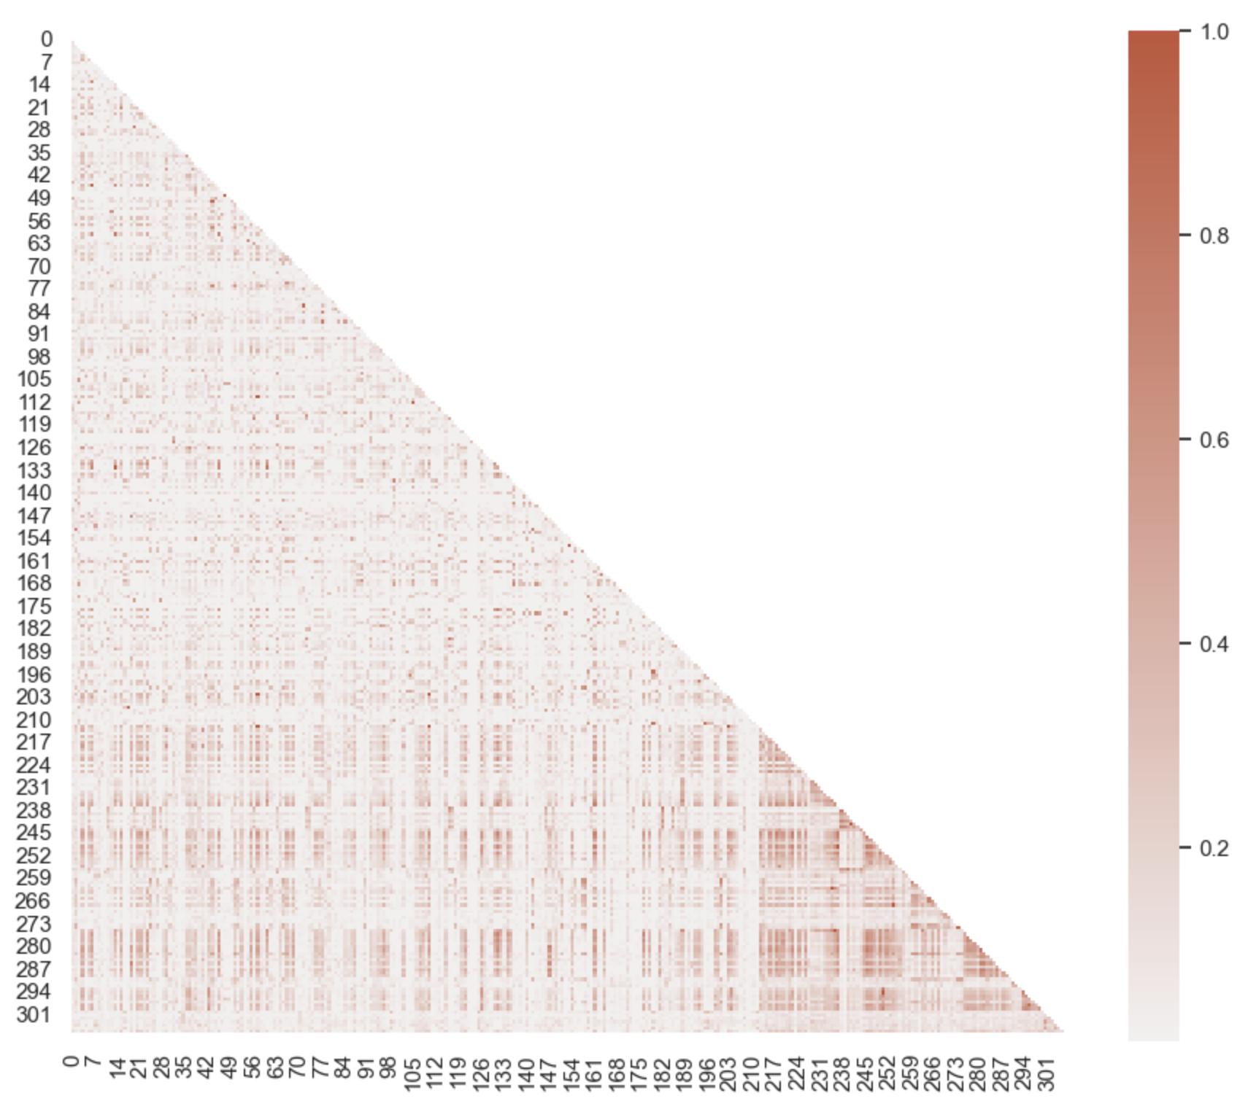
Heatmap for metrics of course similarity
We could use seaborn to visualize the similarity metric, and since it is symmetric, we can just show the triangular matrix (lower left).
As we can see from the heatmap; there are many hot spots, which means many courses are similar to each other. Such patterns suggest that it is possible to build a recommender system based on course similarities.

Slide 19
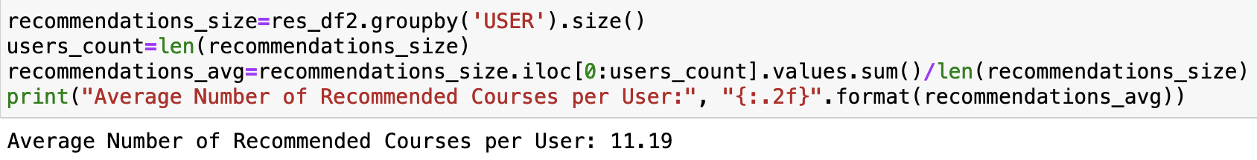
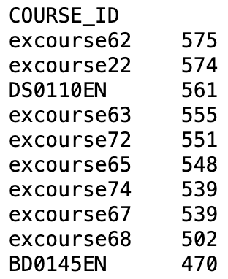
Evaluation results of course similarity based recommender system
Threshold for similarity score for recommendation = 0.6
Maxima count of recommended courses per user = 20
Question: On average, how many new/unseen courses have been recommended per user (in the test user dataset)?
Answer: 11.19
Question: What are the most frequently recommended courses?
Return the top-10 commonly recommended courses across all users

Slide 20
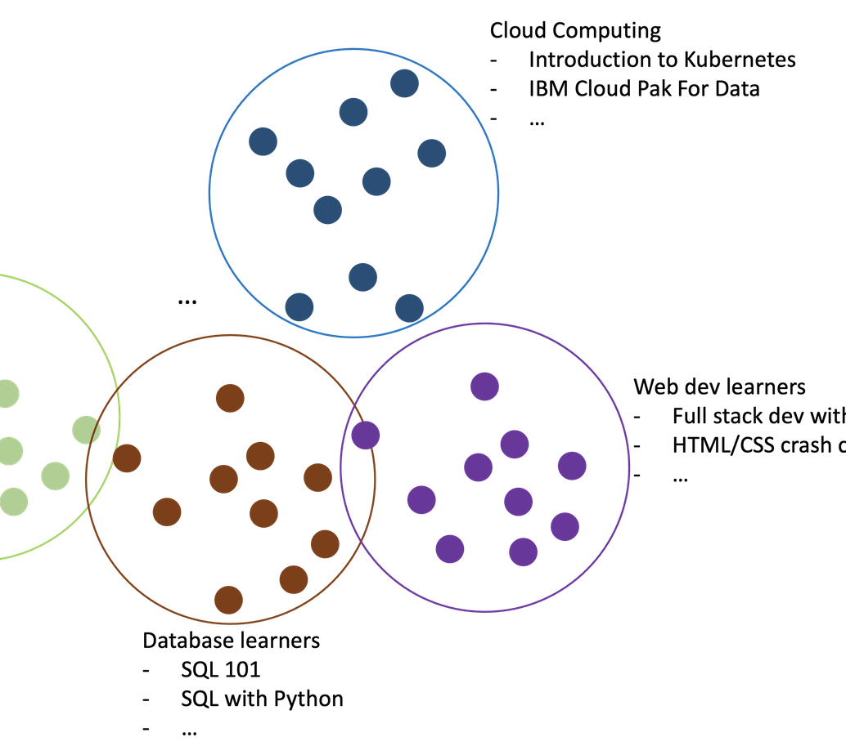
Clustering-based recommender system
In clustering-based recommender system, we apply clustering algorithm such as K-means or DBSCAN to group users with similar learning interests.
For each user group, we can count the most frequently enrolled courses, which are very likely to be most interested by the users in this group
If we know a user belongs to this group, we may recommend these most enrolled courses to the user

Slide 21
Flowchart of clustering-based recommender system
Process user profile features
Cluster Users (optimized hyperparameter: n_cluster=20, n_component=9)
KMeans() -
Grid Search optimized n_cluster
PCA() -
Grid Search optimized n_component
Apply PCA() to
transform features of user profile
Apply KMeans () on PCA transformed features
Assign cluster label to each user
Normalize user profile features
Visualize correlation among features
Recommend courses
For each user, get all courses belonging to the user’s cluster
Select the user’s unenrolled courses
For each course, check if it is popular course
Yes
Heatmap
User profile dataframe
Test user dataframe
Remove courses NOT on top-20 high enrollments
Check if the count of recommended course >20
Yes
Load dataframe
Final course recommendation

Slide 22
Pipeline of clustering-based recommender system
Load
Load Dataframe
Load the dataframe of user profile: contains each user’s interested areas and ratings
Cluster
Cluster users
Recommend
Recommend courses
Check if the count of recommendation is greater than 20. If yes, removed the courses NOT on top-20 high enrollments from recommendation.
Load the test dataframe: contains users to whom we will make recommendation of new courses
Apply PCA(n_component=9) algorithm to transformed user profile features to reduce original 14 features to 9 features
Process
Process features
Nomalize the user profile features using StandardScalere()
Visualize the correlation among user profile features
Apply GridSearch to get the optimized hyper parameters: n_cluster for Kmeans() and n_component for PCA()
Apply Kmeans(n_cluster=20) on PCA transformed features to group users into 20 clusters
Assign each user with a cluster label.
For each user, get all courses within the user’s cluster. Compare all the courses with the user’s enrolled courses to get the user’s unenrolled courses
Check if the user’s enrolled courses are popular courses (count of enrollments >=150). If yes, add the courses to the recommendation.

Slide 23
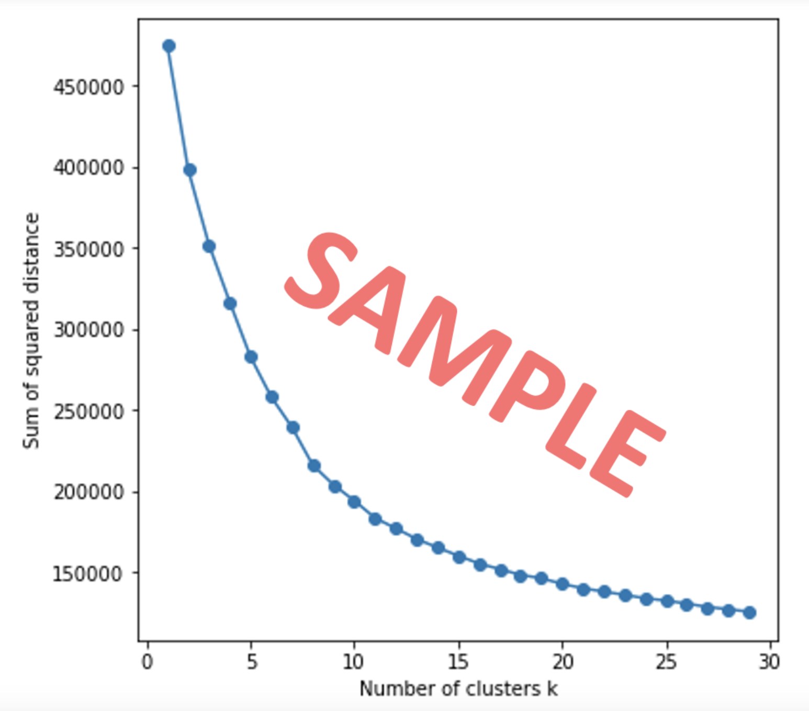
Find the optimized hyperparameter for Cluster()
We use KMeans() algorithm to perform clustering on the user profile feature vectors.
Before we perform KMeans(), we can apply GridSearch to find its optimized hyperparameter, i.e., number of cluster, n_cluster.
Grid search a list of candidates and find the one with the best or optimized clustering evaluation metrics such as minimal sum of squared distance.
From the elbow plot, we can see the point 20 is where the metric starting to be flatten, which indicates the optimized number of clusters.

Slide 24
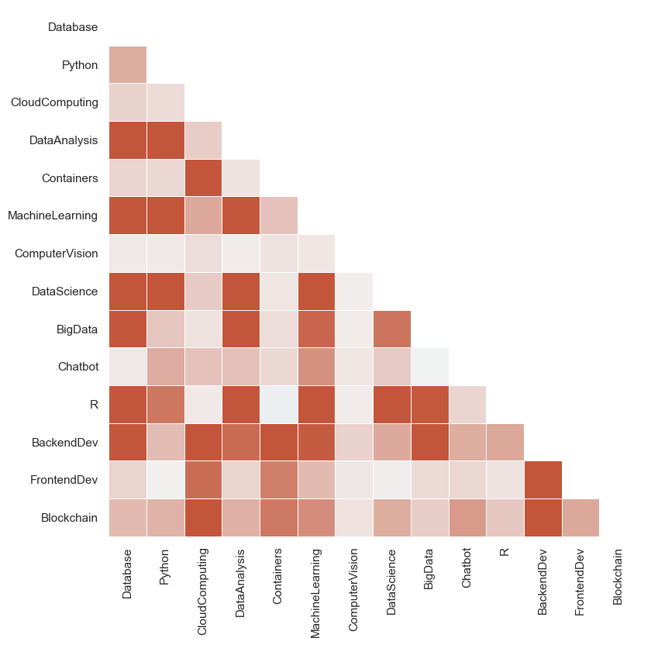
Heatmap for covariance matrix of the user profile feature vectors
We plot a covariance matrix of the user profile feature vectors with 14 features. we can observe that some features are actually correlated.
Such covariances among features may indicate that we can apply PCA to find its main components. If we only keep the independent main components, then we can reduce the dimensions of our user profile feature vectors.

Slide 25
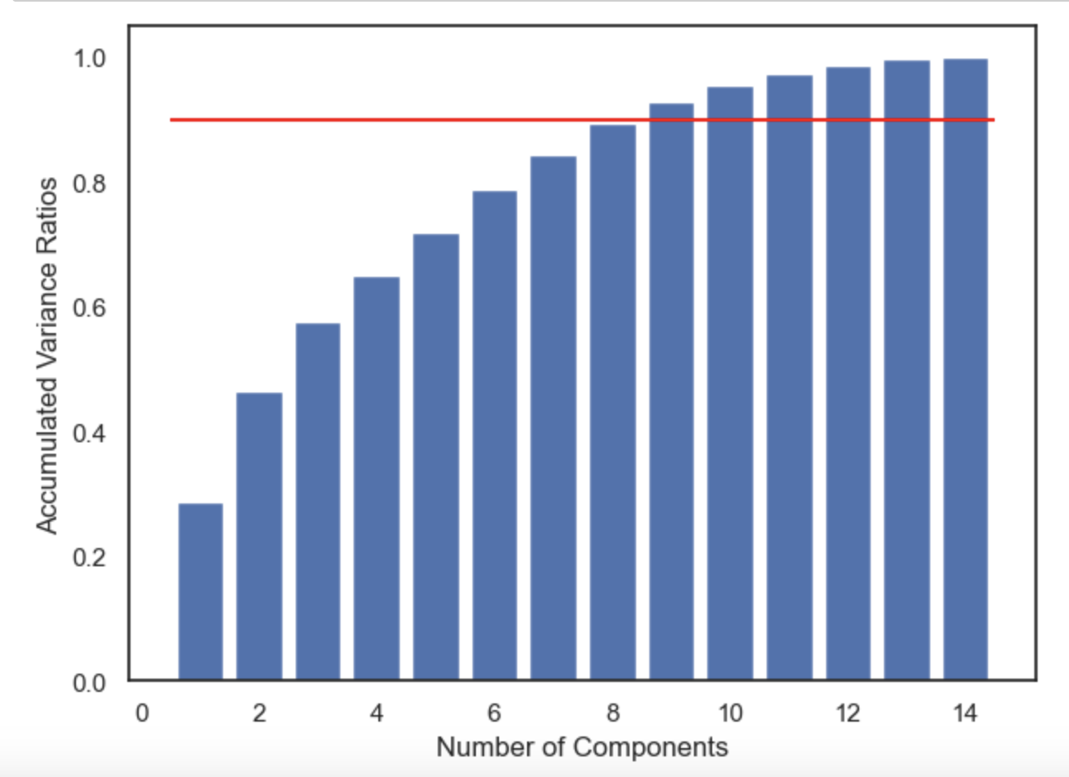
Find the optimized hyperparameter for PCA()
Apply PCA() to find the main components in user profile feature vectors and see if we can reduce its dimensions by only keeping the main components.
When calling the PCA() class, there is an import argument n_component which indicates how many components we want to keep in the PCA result.
We apply Grid search on a list of argument candidates in range(1,15) and then calculate the ratio of the accumulated variance for each candidate.
If the accumulated variances ratio of a argument candidate (i.e. n_components) is larger than threshold 0.9, then we can say the transformed n_components could explain about 90% of variances of the original data variance. Hence is can be considered as an optimized components size.
We select n_component = 9, due to the minimal ratio > 0.9

Slide 26
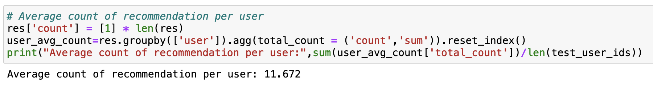
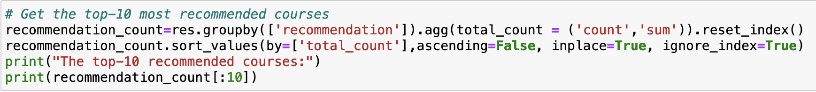
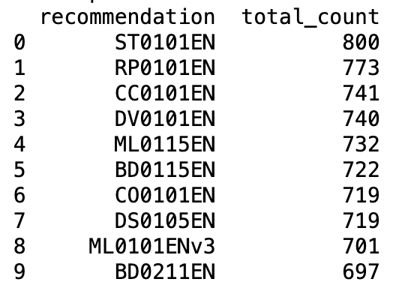
Evaluation results of clustering-based recommender system
For Kmeans(), n_cluster=20
For PCA(), n_component=9
Maximum count of recommendation=20
Question: On average, how many new/unseen courses have been recommended per user (in the test user dataset)
Answer: 11.67
Question: What are the most frequently recommended courses?
Return the top-10 commonly recommended courses

Slide 27
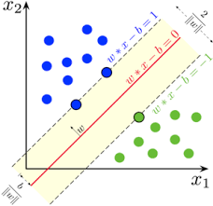
Collaborative-filtering Recommender System using Supervised Learning

Slide 28
Overview for collaborative-filtering recommender system
Collaborative filtering is probably the most commonly used recommendation algorithm, the following are two main types of methods which work similarly:
User-based collaborative filtering is based on the user similarity or neighborhood
Item-based collaborative filtering is based on similarity among items
For most collaborative filtering-based recommender systems, the main dataset format is a 2-D matrix called the user-item interaction matrix. In the matrix, each row vector represents the rating history of a user and each column vector represents the users who rated the item.
For user-based collaborative filtering, we determine if two users are similar, we can simply calculate the similarities between their row vectors in the interaction matrix. Then based on the similarity measurements, we can find the k nearest neighbor as the similar users.
For item-based collaborative filtering, we look at the user-item matrix vertically and determine if the items (courses) are similar. If two courses are enrolled by two groups of similar users, then we could consider the two items are similar and use the known ratings from the other users to predict the unknown ratings by which we may determine if a course can be recommended to a specific user.

Slide 29


Flowchart of KNN-based recommender system
Perform KNN-based collaborative filtering
Convert to sparse matrix
Split the dataset
Define the model KNNBasic()
KNNBasic(min_k=1,
max_k=50,
sim_options={”name”: “cosine”,
“user_based”: False})
Dataframe of user-item interaction matrix
Train the model KNNBasic()
Training set
Load dataframe
Predict the rating of unknown courses
Measure the prediction accuracy
Testing set

Slide 30
Pipeline of KNN-based recommender system
Load
Load Dataframe
Load the dataframe of a user-item (learn-course) interaction matrix, contains 3 columns: user id (learner), item id (course), and rating (enrollment mode)
Split
Split the data
Train the model KNNBasic() provided by scikit-surprise library, which is defined as follows:
Compute the cosine similarity between items (item-based)
Evaluate
Predict the rating and evaluate result
Train
Convert the original form of matrix to a sparse matrix using pivot
Split the data into training set and test set. Size of test set = 0.3. Training set will be used for training algorithm. Testing set will be used for predict rating.
Maximum number of neighbors = 50, minimum number of neighbors = 1
Measure prediction accuracy by computing RMSE (root mean square error). accuracy.rmse(predictions) = 0.1943
Predict rating of unknown items based on the aggregation of the user's K nearest neighbor's ratings

Slide 31
Flowchart of NMF-based recommender system
Perform KNN-based collaborative filtering
Convert to sparse matrix
Split the dataset
Define the model NMF ()
NMF(verbose=True,
random_state=123,
init_low=0.5,
init_high = 5.0,
n_factors=32)
Dataframe of user-item interaction matrix
Train the model NMF()
80% Training set
Load dataframe
Predict the rating of unknown courses
Measure the prediction accuracy
20% Testing set

Slide 32
Pipeline of NMF-based recommender system
Load
Load Dataframe
Load the dataframe of a user-item (learn-course) interaction matrix, contains 3 columns: user id (learner), item id (course), and rating (enrollment mode)
Split
Split the data
Train the model NMF() provided by scikit-surprise library, which is defined as follows:
Evaluate
Predict the rating and evaluate result
Train
Convert the original form of matrix to a sparse matrix using pivot
Split the data into training set and test set. Size of test set = 0.3. Training set will be used for training algorithm. Testing set will be used for predict rating.
Measure prediction accuracy by computing RMSE (root mean square error). accuracy.rmse(predictions) = 0.1924
Predict rating
NMF(verbose=True, random_state=123, init_low=0.5, init_high = 5.0, n_factors=32)

Slide 33
Flowchart of Neural Network Embedding based recommender system
Feature Engineering
Generate training, testing and validating dataset
Convert course genre to item one-hot encoded vector
0 | 1 | 1 | 0 | …
1 | 0 | 0 | 0 | …
1 | 1 | 1 | 0 | …
… | … | … | … | …
0 | 1 | 1 | 1 | …
Define and train the model RecommenderNet
1 | 0 | 1 | 1 | …
0 | 1 | 1 | 0 | …
1 | 0 | 0 | 0 | …
… | … | … | … | …
0 | 0 | 0 | 1 | …
Encoded dataset
Convert user profile to user one-hot encoded vector
80% Training
Predict the rating of unknown courses
10% Testing
Course rating
10% Validating
Dataframe of user rating
Evaluate model performance by RMSE
Load dataframe

Slide 34
Pipeline of Neural Network Embedding based recommender system
Load
Load and process dataframe
Load the rating dataset, contains 3 columns: user id (learner), item id (course), and rating (enrollment mode)
Split
Split the data
Train the model
Evaluate
Evaluate the prediction accuracy of the model
Train
Split the data into 3 sets for training on 80% of the data, validating on 10% o the data, and testing on remaining 10% of the data
Call model.evaluate() method to evaluate the model: RMSE = 0.2159
Process
Process features
Convert the actual user ids and item ids into integer indices for tensorflow to creating 2 one-hot encoding vectors, one for users, and another for items.
Define the mode RecommenderNet() as a subclass inheriting the tensorflow.keras.Model super class. The input of the model will be the users and items one-hot encoding vectors. The output will be the predicted course rating.
Call model.compile() method to set up the loss and optimizer and metrics for the model training as follows:
optimizer =SGD(learning_rate=.003), loss = "MeanSquaredError", metrics=["RootMeanSquaredError"]
Call model.fit() method to train the model.

Slide 35
Compare the performance of collaborative-filtering models
The bar chart above shows the performance measured by RMSE (Root Mean Squared Error) for various collaborative filtering models built to predict the course rating in this analysis.
The colors of the bars in the chart above represent different types of models. For example, green bars present performance of regression-based models, and purple bars present the performance of classification-based models
The closer RMSE is to 0, the more accurate the model is. Hence, the SVC classification model is considered to the best model in this analysis.

Slide 36

Conclusions

Slide 37
Content-based recommender using unsupervised algorithms
Course-similarity based course recommender
User-profile based course recommender
Clustering based course recommender
In this analysis, I have built 3 types of content-based recommender systems using various unsupervised algorithms.
The 3 types of content-based recommender systems results in different set of top-10 recommended courses.
I would consider next to investigate further and assess which type could work better than the others for recommendation

Slide 38
Collaborative-filtering recommender system
Various types of collaborative filtering-based recommender systems were built using different types of algorithms in this analysis as below:
KNN (K Nearest Neighbor)
NMF (Non-negative Matrix Factorization)
Neural Networks
Regression with embedding features
Classification with embedding features
Evaluating the performance of the models by RMSE metrics, our findings are as follows:
Among total 14 models created in this analysis, the classification algorithm SVC works the best on prediction of course rating.
In general, the classification algorithms works better than the other types of algorithms (i.e. regressiom, neural networks, NMF, KNN)
Among the 5 regression models created in this analysis, after tuning the hyperparameters using GridSearchCV method, the algorithm Gradient Boosting Regressor works significantly better than the other regression models in prediction of course rating

Slide 39
Next Step
My interest for next step on recommender system is to build a movie recommender system and pass through each required step in this analysis to find out the best movie recommender model
The features to be extracted when building such movie recommender, are not only the audience‘s interest and rating on movies, but also the audience’s features such as gender, age, education, profession, country …etc. I think these features would also affect the audience’s movie selection and hence the recommender models should include them as part of input for training and testing.

Slide 40

Appendix
Instructions for learner:
Include any relevant assets like a GitHub repo, key Python code snippets, charts, notebook outputs, or deployed Streamlit app URLs that you may have created during this project
Asset 1
Asset 2
Asset 3
Asset 4
…

